Slide 1
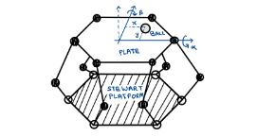
BALL & PLATE CONTROLLER
CP241: ALNC Lab Project – Team 2
Team members:
Soumyadipta Nath, G Magesh, Rithwik Pradeep & Ganga Nair B

Slide 2
PRESENTATION OUTLINE
System Description
Mathematical model
Literature Review
Implementation of Control Algorithms
PID
LQR
SMC
Comparison of Results
Conclusion

Slide 3
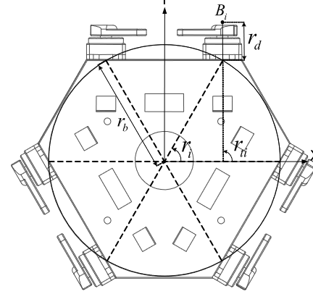
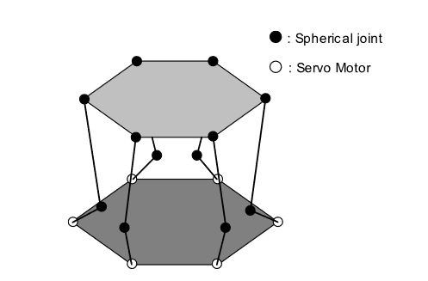
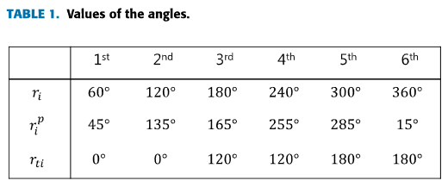
DESCRIPTION OF THE SYSTEM
Consider a ball kept on a plate controlled through a Stewart platform with rotary actuators. Design a control strategy to track a circular orbit on the platform with the ball.

Slide 4
MATHEMATICAL
MODEL

Slide 5
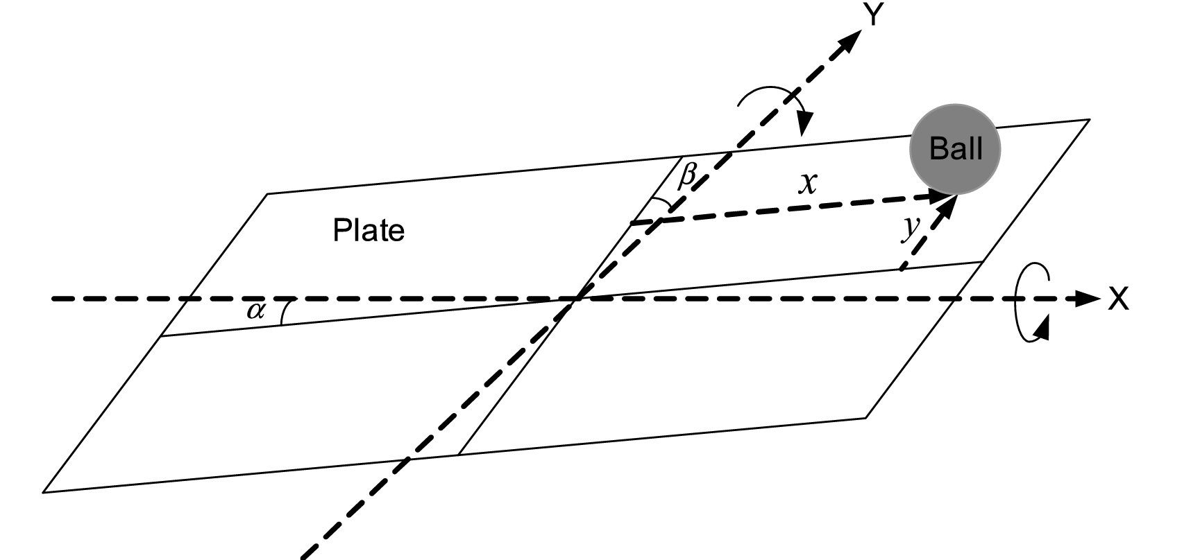
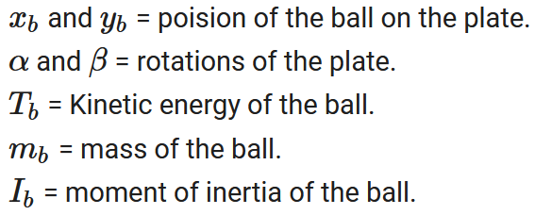
MATHEMATICAL MODEL
The Ball-Plate system can be visualised in the following manner in order to obtain the states of the system,

Slide 6
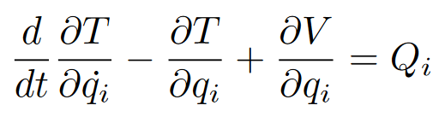
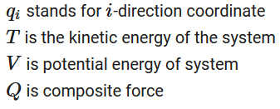

MATHEMATICAL MODEL
The Euler-Lagrange equation of ball-plate system can be written as following:
The Kinetic Energy of the ball is given by

Slide 7




MATHEMATICAL MODEL
Assuming that the ball undergoes pure rolling (without slipping) and that it does not spin around the z-axis, we get,
Thus Kinetic Energy of the ball become
The relative potential energy of the ball with respect to the horizontal plane passing by the center of the inclined plate is given by,

Slide 8
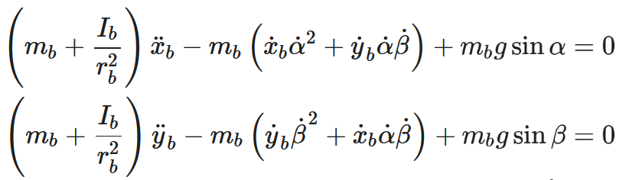
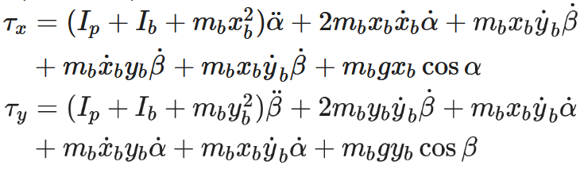
MATHEMATICAL MODEL
From the Euler-Lagrange equation, the dynamics of the system is given by,
The corresponding relation with external torque is given by,

Slide 9


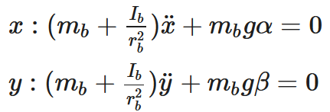
MATHEMATICAL MODEL

Slide 10


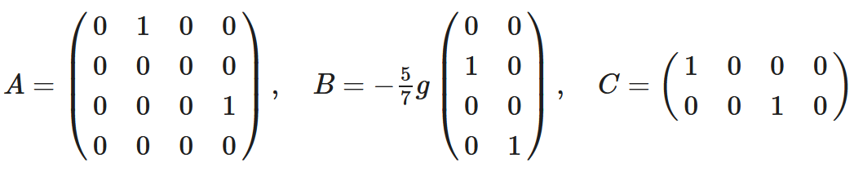
MATHEMATICAL MODEL

Slide 11
LITERATURE REVIEW
Implementation of a Ball and Plate Control System Using Sliding Mode Control ¹
The paper proposes a cost-effective implementation method of ball & plate control system and implements Sliding Model Control scheme
The system dynamics are presented, along with the inverse kinematics
The non-linear control technique of SMC is formulated, with states formulated as errors, its derivative and integral
It defines the sliding surface as a function of these three terms and finds the control input.
In order to avoid chattering due to usage of signum function in SMC, this paper uses a sigmod-like function
The paper shows the asymptotic stability of the controller using Lyapunov function and provides simulation results for tracking a circular trajectory.
¹H. Bang and Y. S. Lee, "Implementation of a Ball and Plate Control System Using Sliding Mode Control," in IEEE Access, vol. 6, pp. 32401-32408, 2018

Slide 12
LITERATURE REVIEW
Comparison Between Different Methods of Control of Ball and Plate System with 6DOF Stewart Platform ²
The paper implements four different controllers for control of the system
The system dynamics are presented based on Euler-Lagrange equations
The paper considers performance requirements such as response time, maximum overshoot and steady-state error of the outputs, in order to compare between the different methods of control.
The paper implements PID, LQR, SMC & Fuzzy controllers
The paper produces the simulation results and does a performance comparison between these controllers
The results show that SMC performs better than the other three techniques, with better response times, lower steady state errors while tracking both static and dynamic reference trajectories, as it overcomes modeling imprecision and parameter variations
²Aghiad KASSEM, Hassan HADDAD, Chadi ALBITAR,Comparison Between Different Methods of Control of Ball and Plate System with 6DOF Stewart Platform,
IFAC-PapersOnLine, Volume 48, Issue 11, 2015, Pages 47-52

Slide 13
LITERATURE REVIEW
Model Predictive Control of a Ball and Plate laboratory model ³
The paper implements MPC, which is a state predictive control algorithm and this paper uses linear predictor for the states
It presents the model of the system, linear predictor and the cost function that needs to be minimized over the horizon of prediction & control
It uses the reference trajectory and the predicted states to arrive at the optimal control law, which minimizes the cost function
It implements the models for ball & plate system as well as the servo motors
It implements the linear state predictor based on the linearization of system dynamics using Jacobian matrix around the equilibrium point
Simulation as well as experimental results are provided for MPC towards tracking circular and square trajectories
³Oravec, M., & Jadlovská, A. (2015). Model Predictive Control of a Ball and Plate laboratory model. 2015 IEEE 13th International Symposium on Applied Machine Intelligence and Informatics (SAMI), 165-170.

Slide 14
IMPLEMENTATION OF CONTROL ALGORITHMS

Slide 15



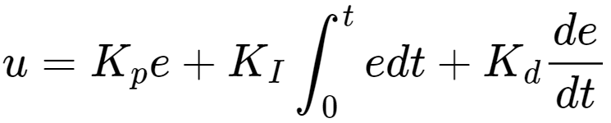
Proportional Integral Derivative (PID)
Error is defined as , where, denote the desired and current states of the ball respectively.
Here, state refers to the position of the ball on the plate with respect to the plate’s surface, thus,
Thus, the control input can be designed as,
It has been implemented in MATLAB, resulting in relatively poor tracking results.

Slide 16
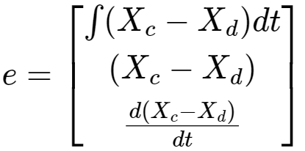
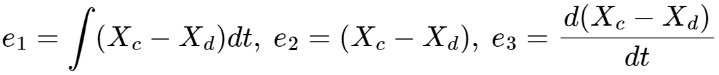
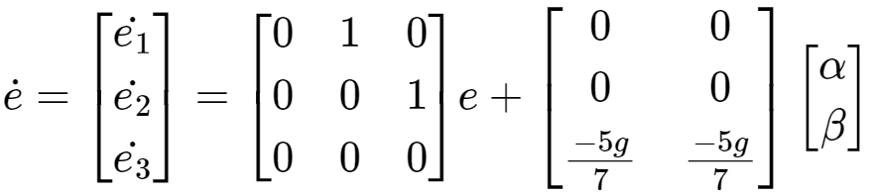
2. Sliding Mode Control
The error dynamics is defined as:
→ Integral of error in position,
→ Error in current position and desired position of ball
→ Error in current and desired velocities of the ball
Thus, the derivative of error with respect to time is given by:

Slide 17
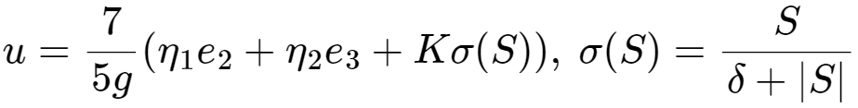
2. Sliding Mode Control
The sliding surface can be designed as,
Thus, the control input can be designed as,
This sigma function shown has been introduced to reduce chattering effect near the sliding surface.
The control input ensures that the error states reach the sliding surface in finite time and asymptotically converge to zero
Contd...

Slide 18


2. Sliding Mode Control (Contd…)
Thus, the control input is as follows,
Here and the convergence rate of the error states towards the sliding surface, increasing and reducing makes the system more aggressive in the Sliding Phase.
Overall the control technique is robust to additional disturbances in plate or joint angles due to defective build or non-ideal effects.
Changing affects the asymptotic convergence of the error states in the Reaching Phase.
It has been implemented in MATLAB and SIMULINK.

Slide 19









3. Linear Quadratic Regulator (LQR)
The linearized system is of the form
The goal is to find the optimal control law that minimizes the
cost function where and
The gain matrix is computed as where is the solution of the Riccati Equation
Since the controller needs to track the reference trajectory, the state feedback is implemented as where is the desired state and is the current state
MATLAB command ‘lqr’ has been used to compute the gains and the controller has been implemented

Slide 20
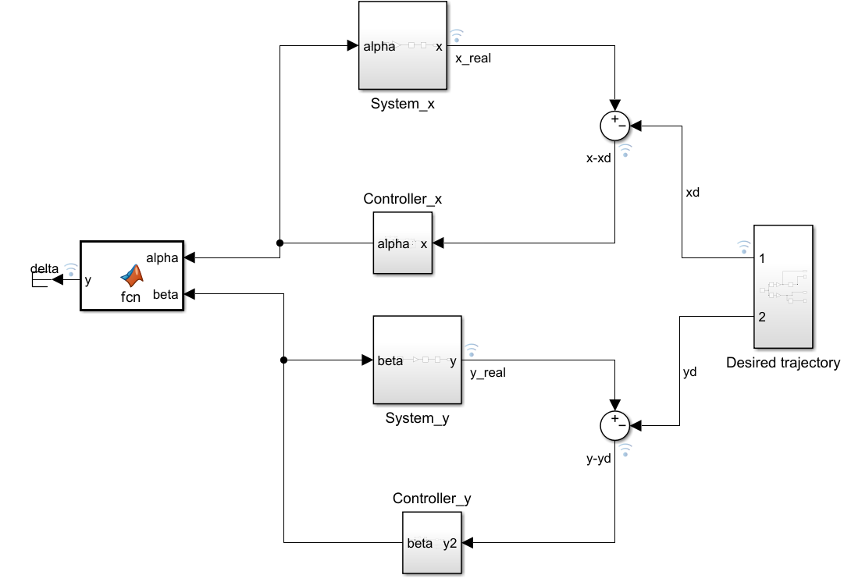
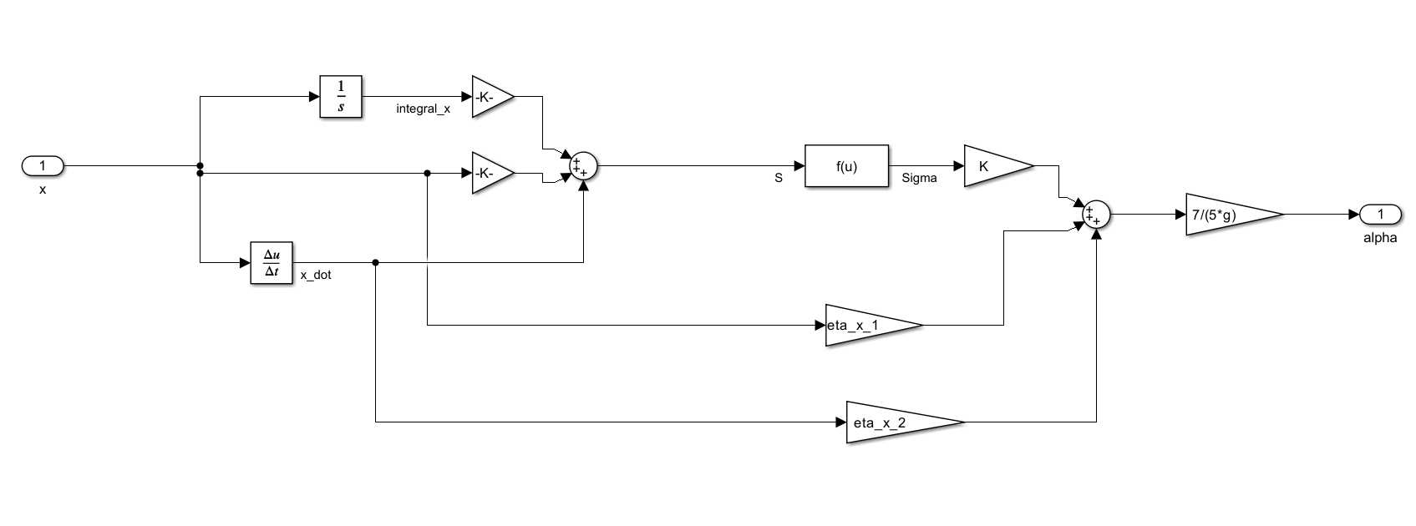
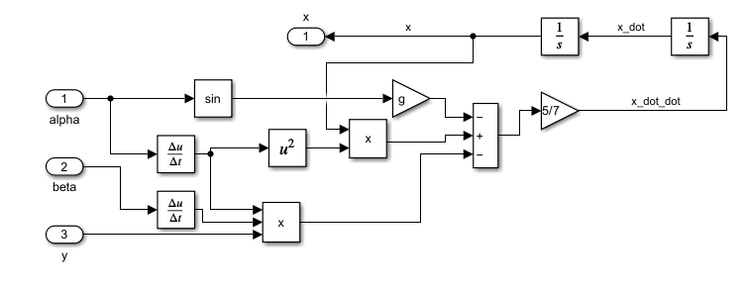
IMPLEMENTATION IN SIMULINK

Slide 21
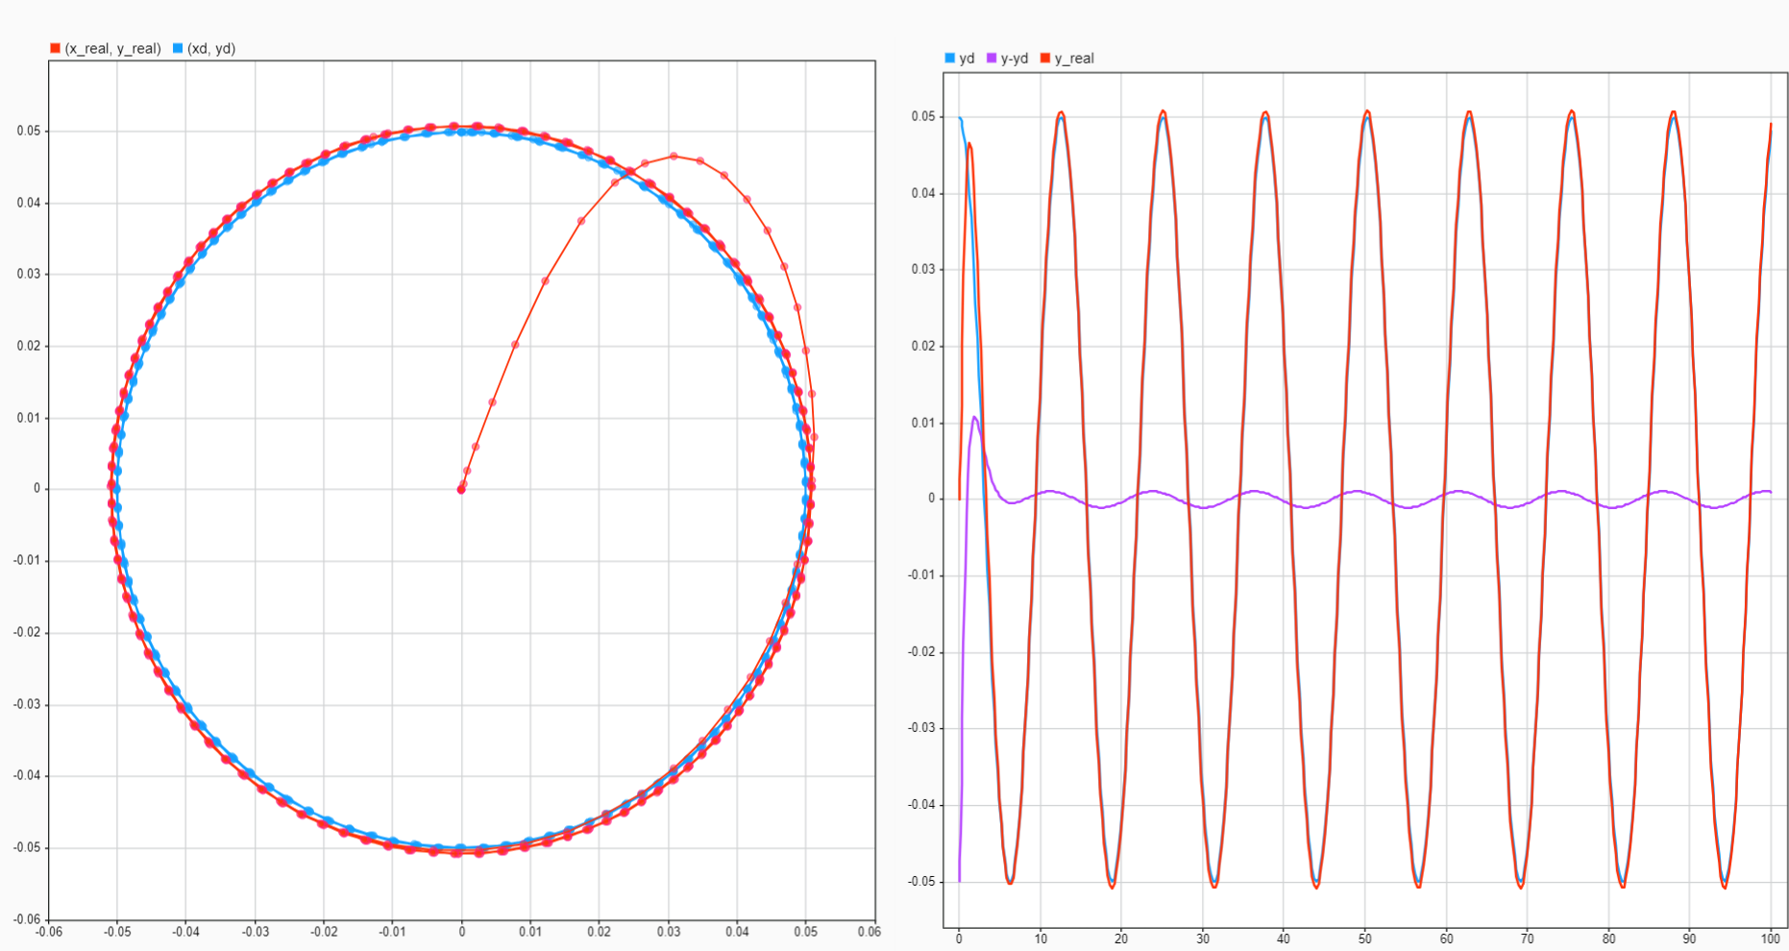
IMPLEMENTATION IN SIMULINK

Slide 22
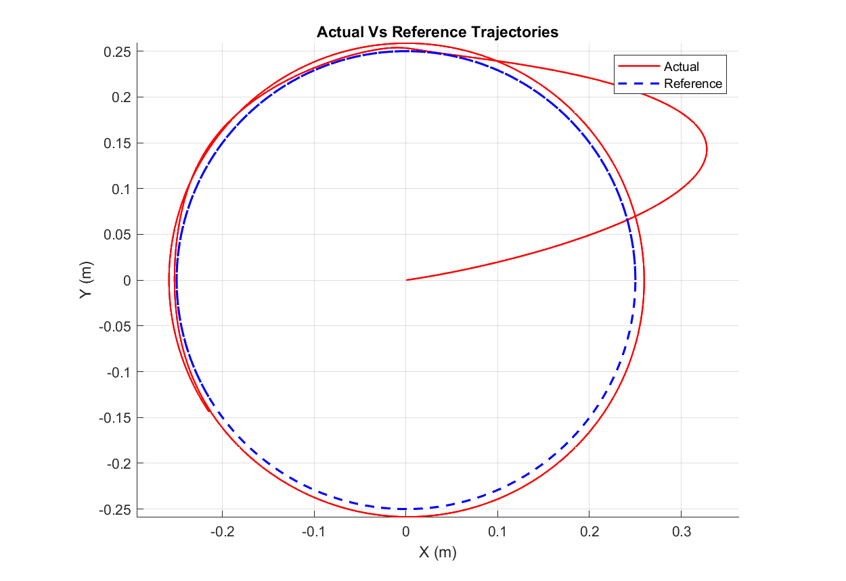
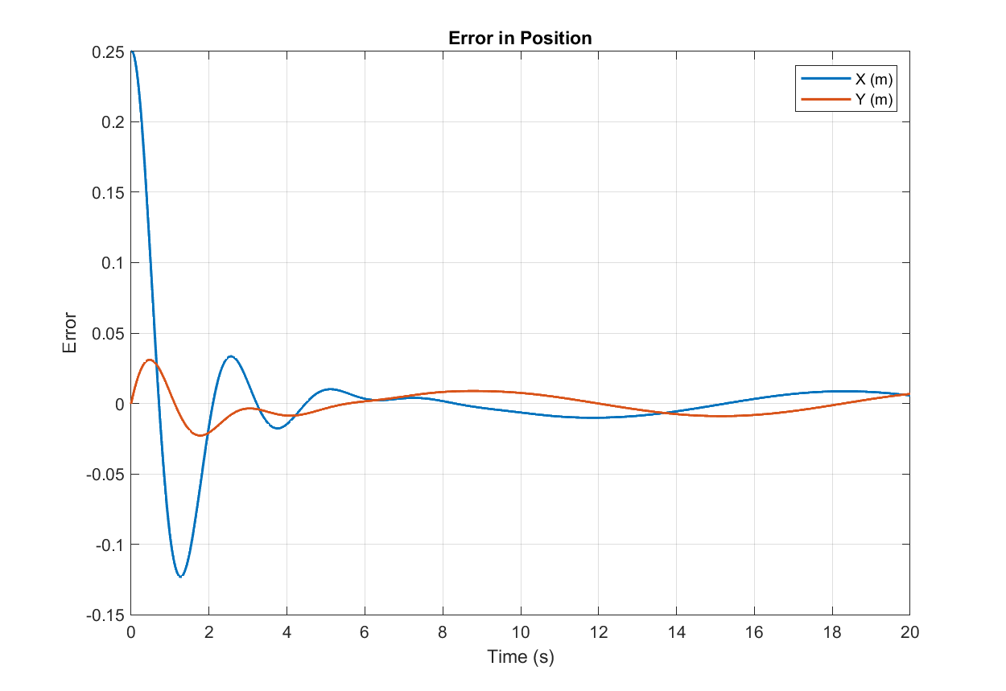
RESULTS
Circular Trajectory - PID

Slide 23
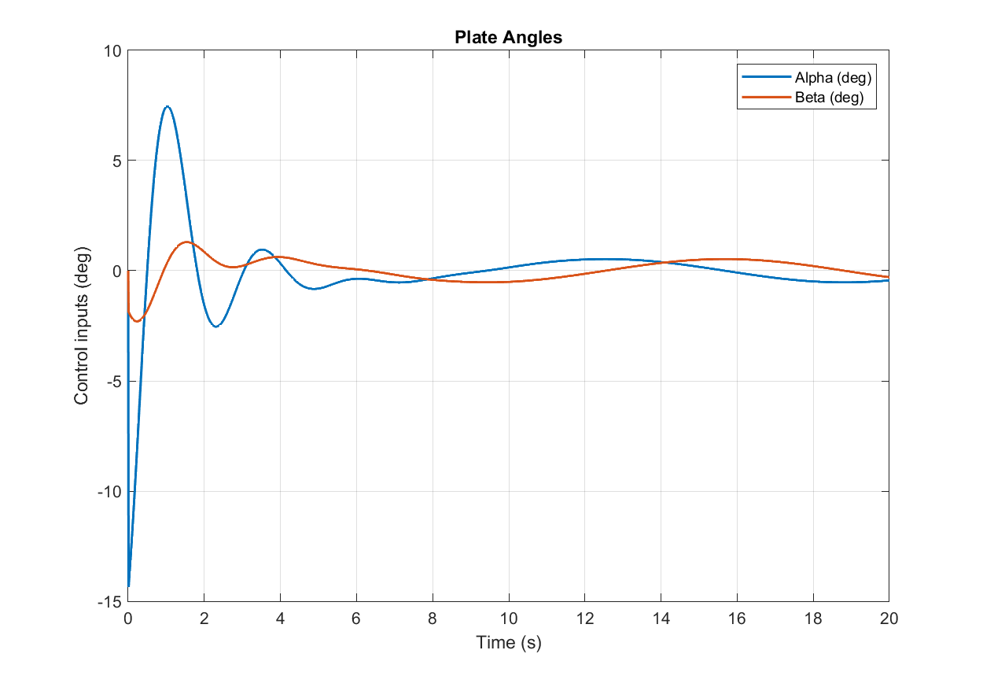
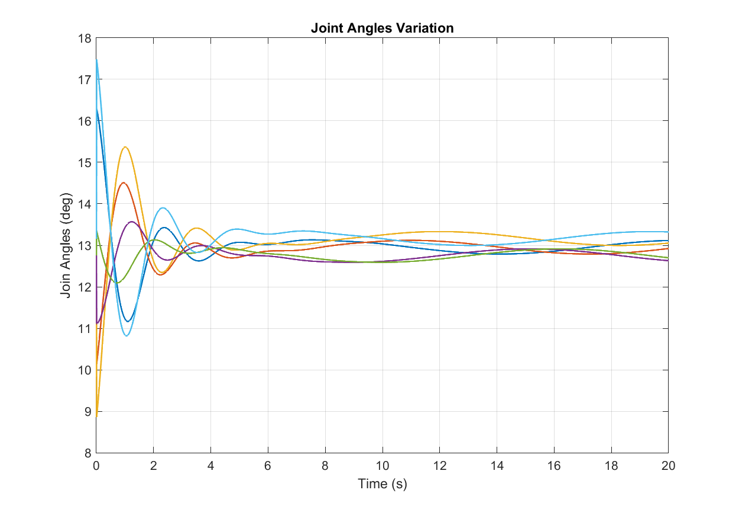
RESULTS
Circular Trajectory - PID

Slide 24
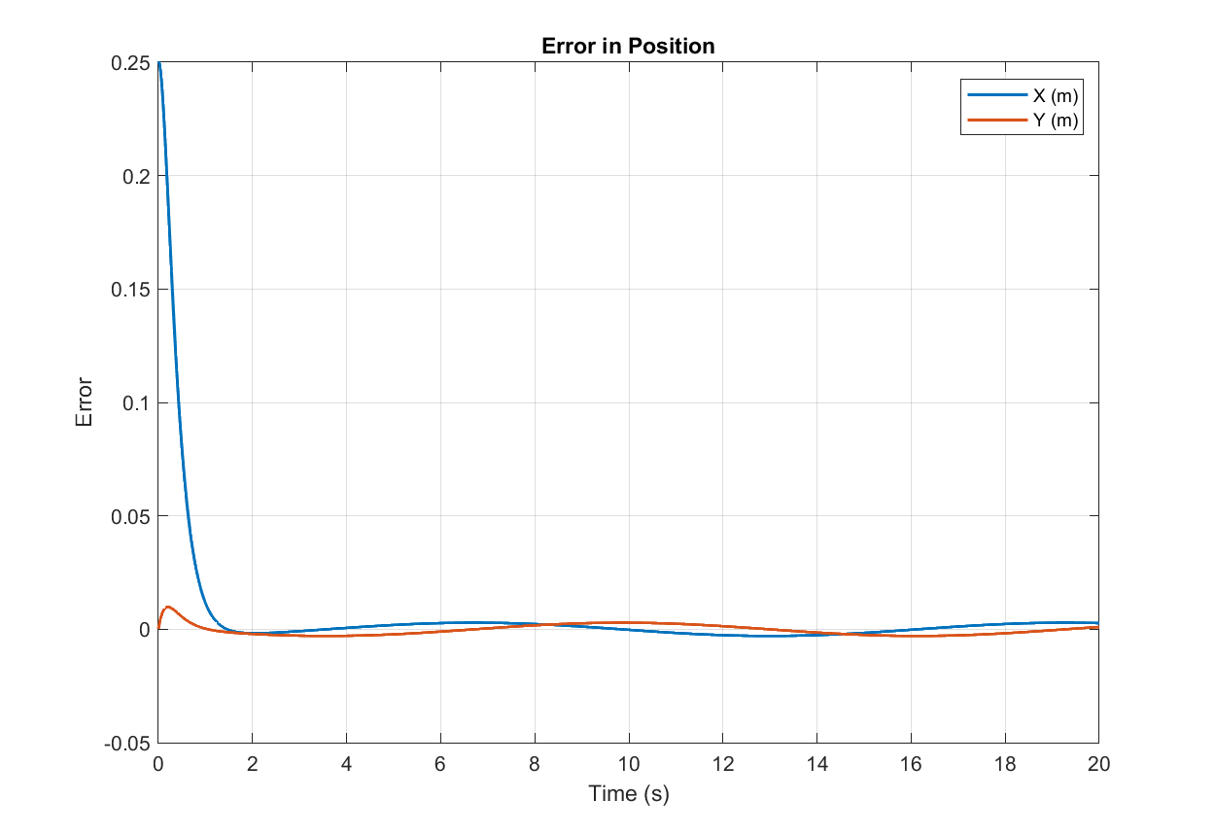
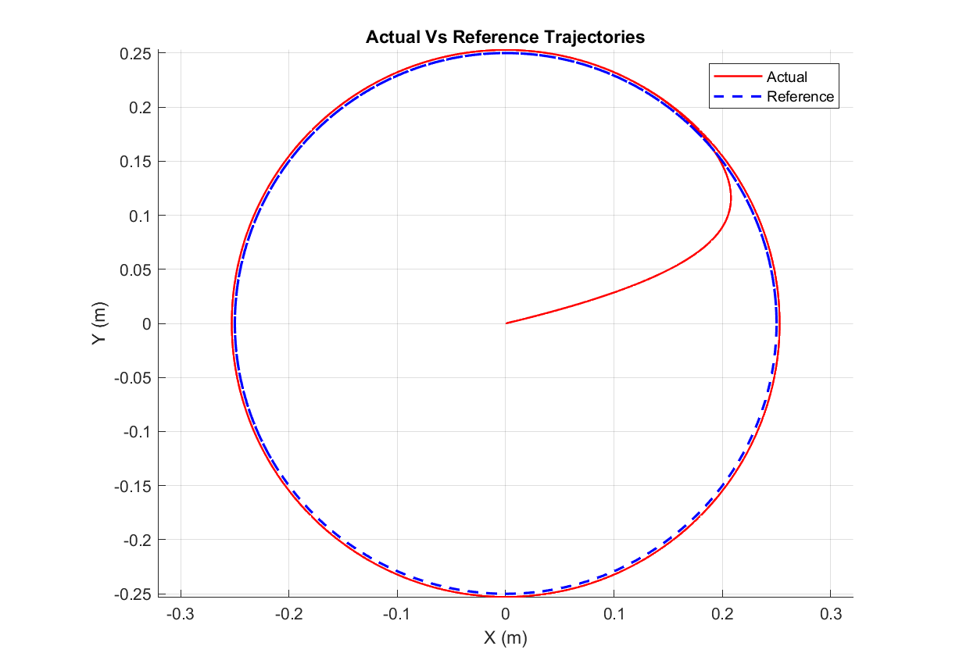
RESULTS
Circular Trajectory - LQR

Slide 25
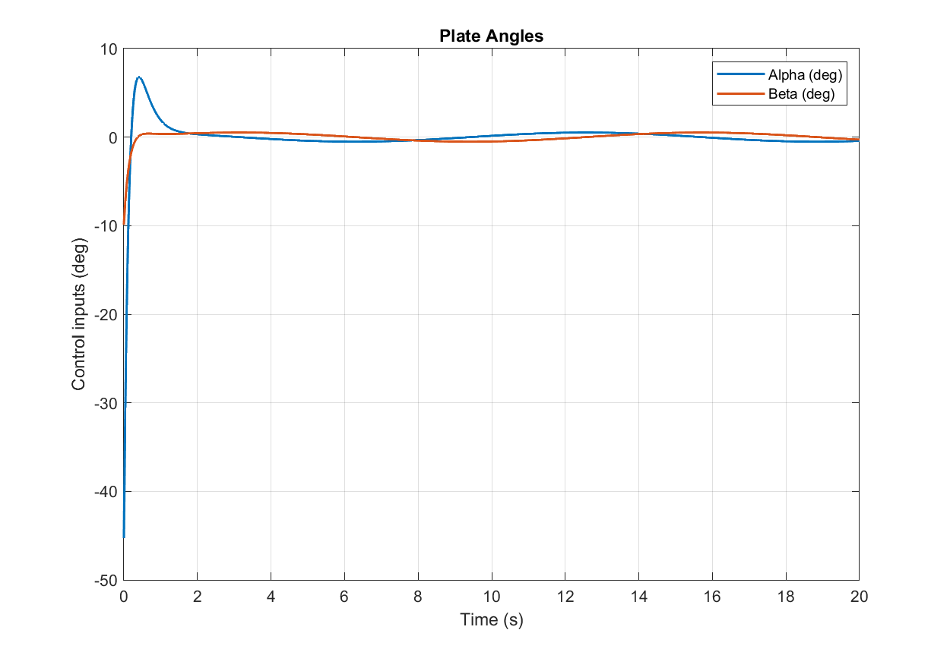
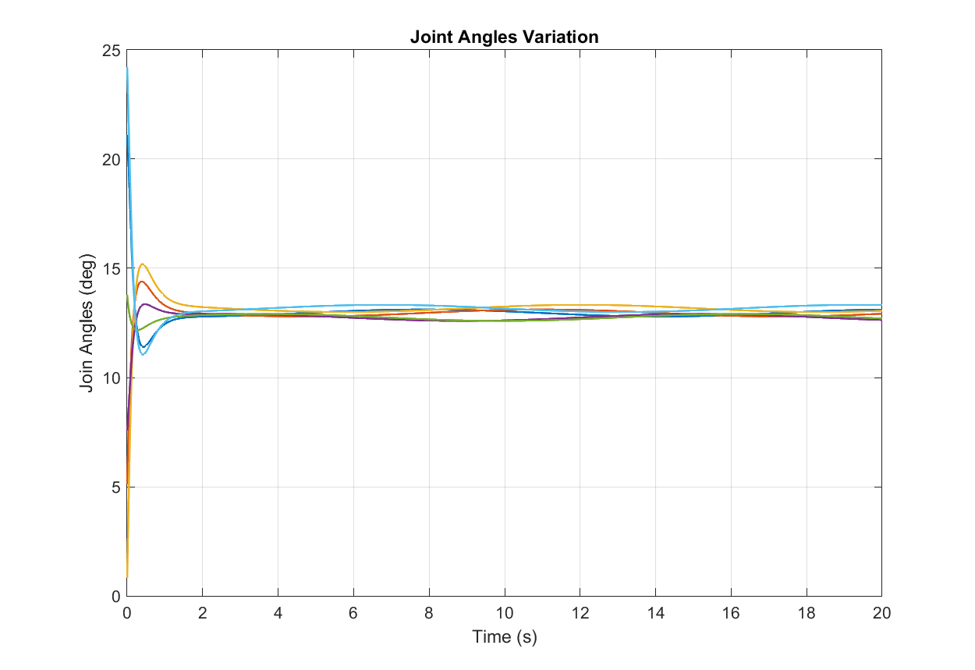
RESULTS
Circular Trajectory - LQR

Slide 26
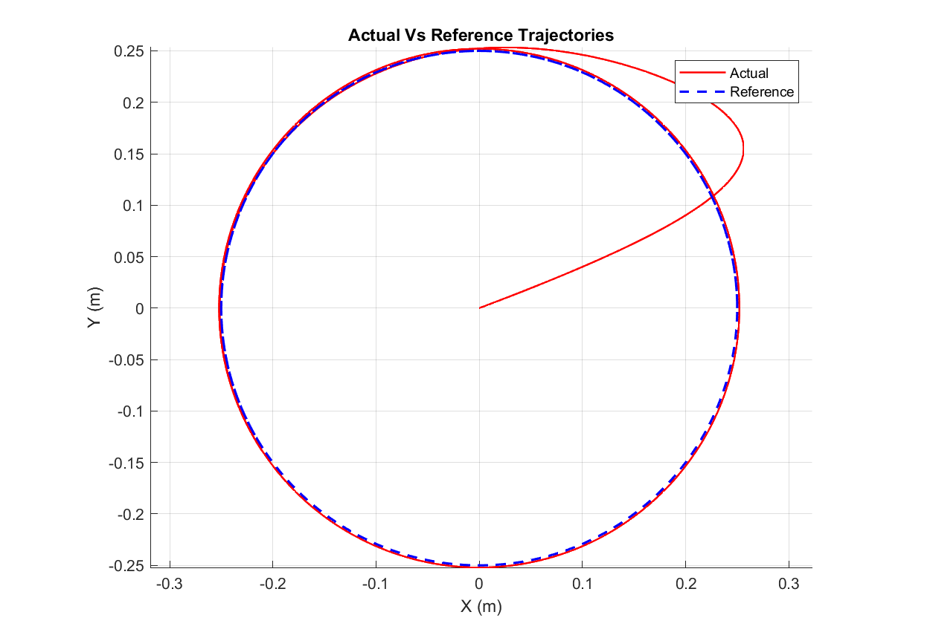
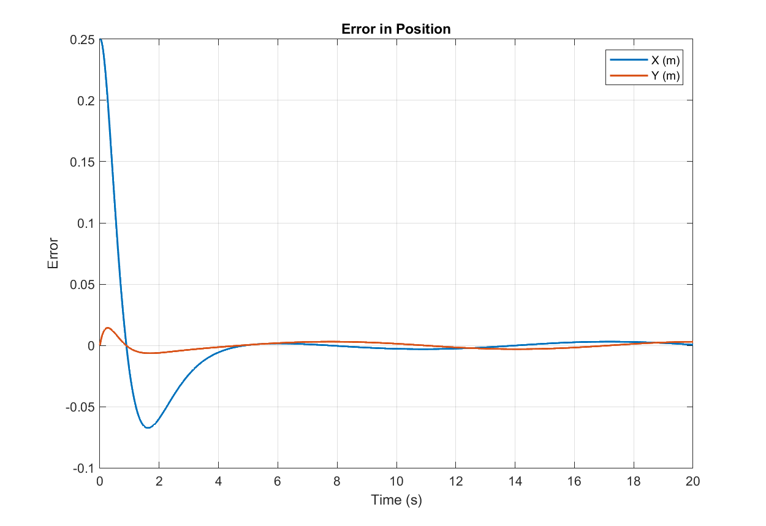
RESULTS
Circular Trajectory - SMC

Slide 27
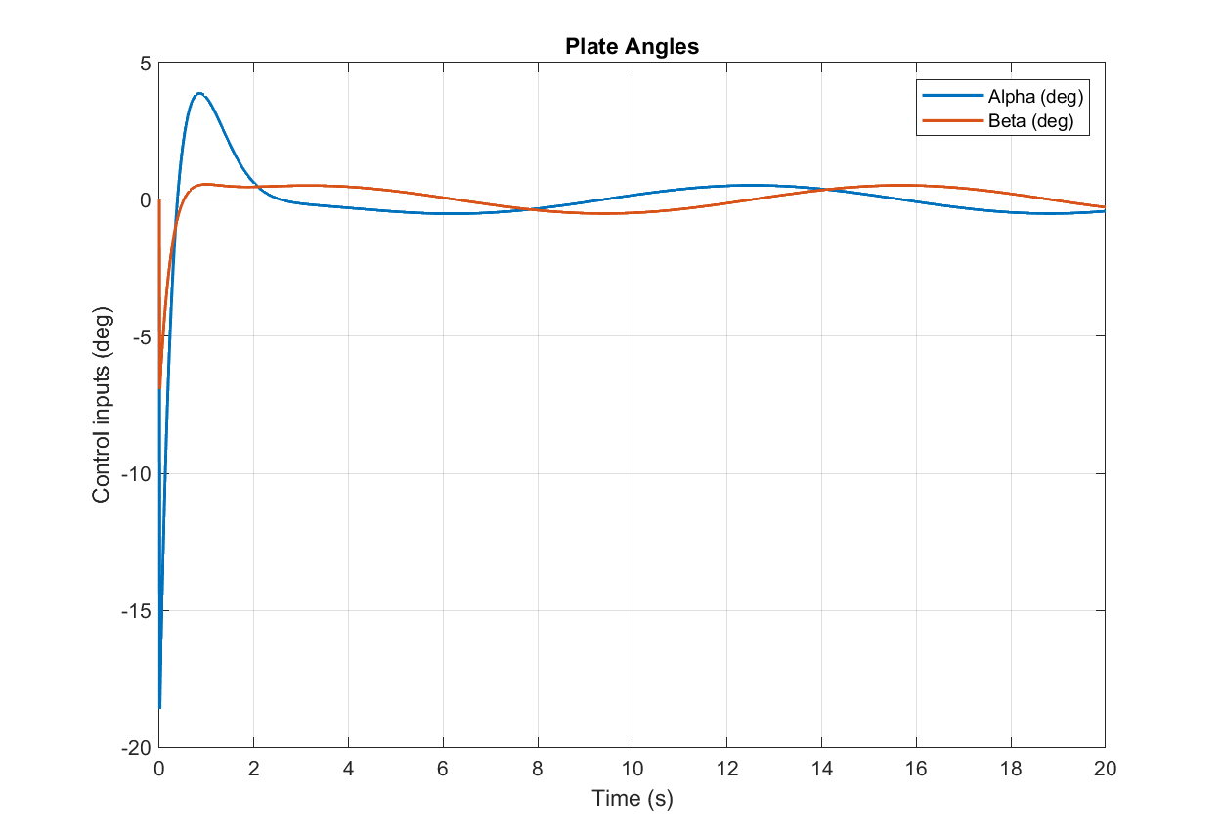
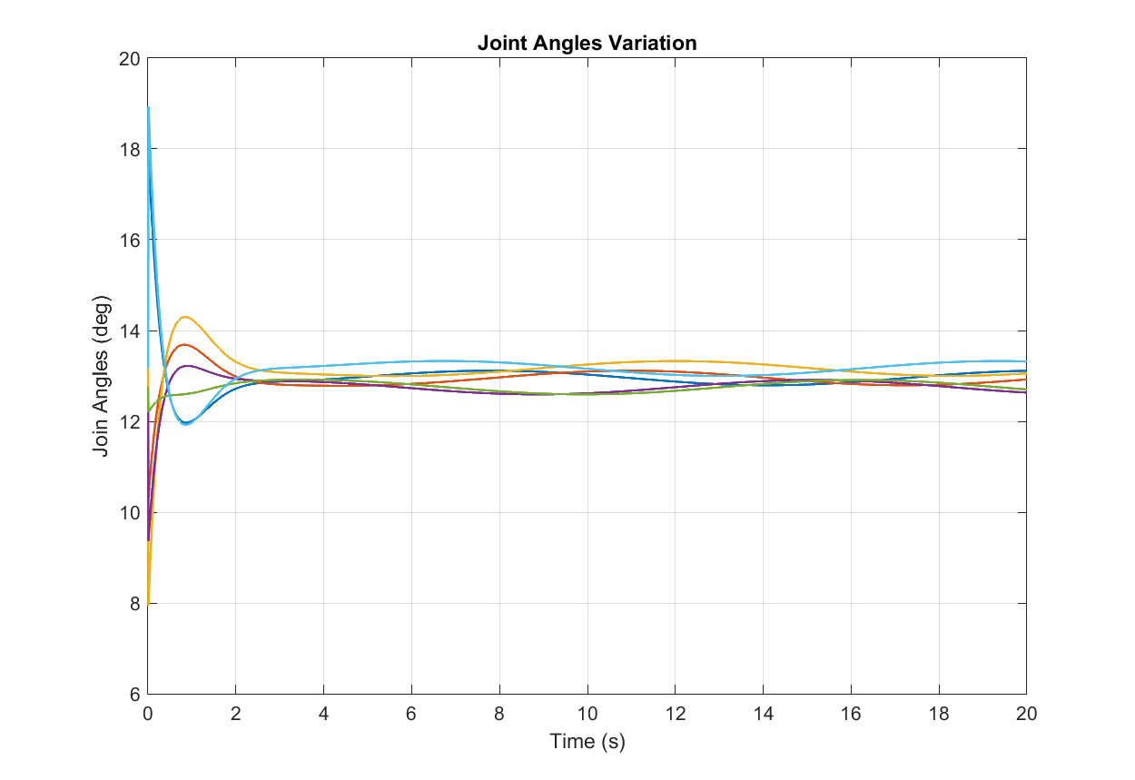
RESULTS
Circular Trajectory - SMC

Slide 28
PID | Rise time: 0.64 sec Settling time: 4.08 Steady state error: 0.0101
LQR | Rise time: 0.85 sec Settling time: Steady state error: 0.0127
SMC | Rise time: 0.8 sec Settling time: 3.5 Steady state error: 0.0041

Slide 29
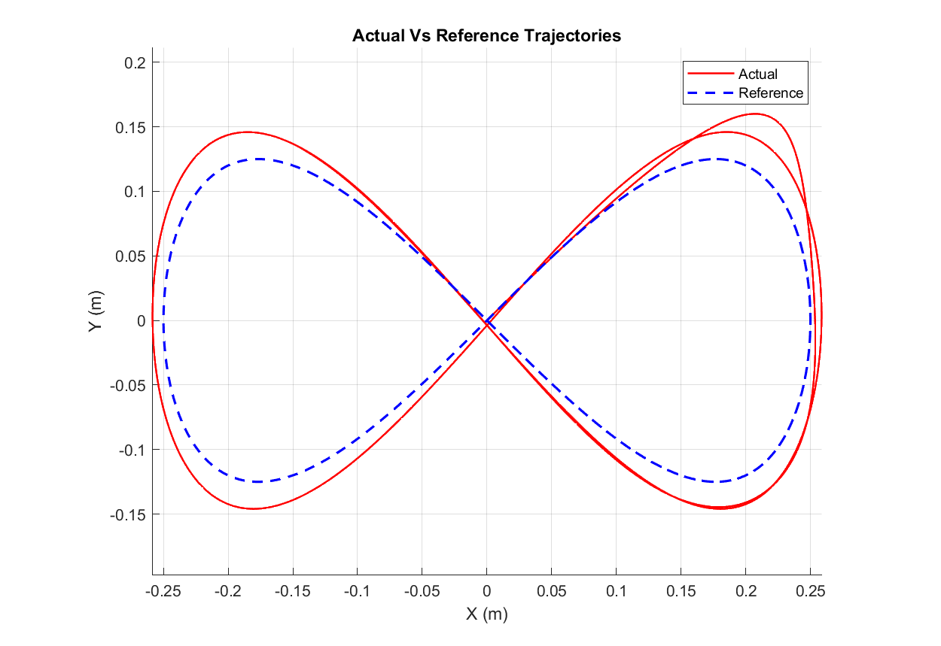
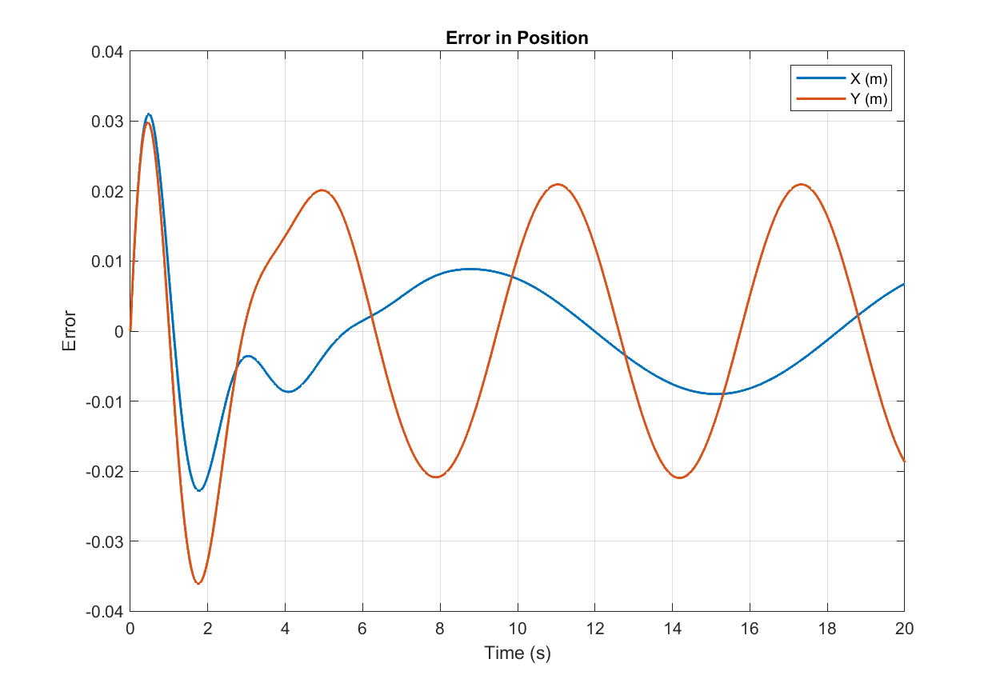
RESULTS
Figure 8 Trajectory - PID

Slide 30
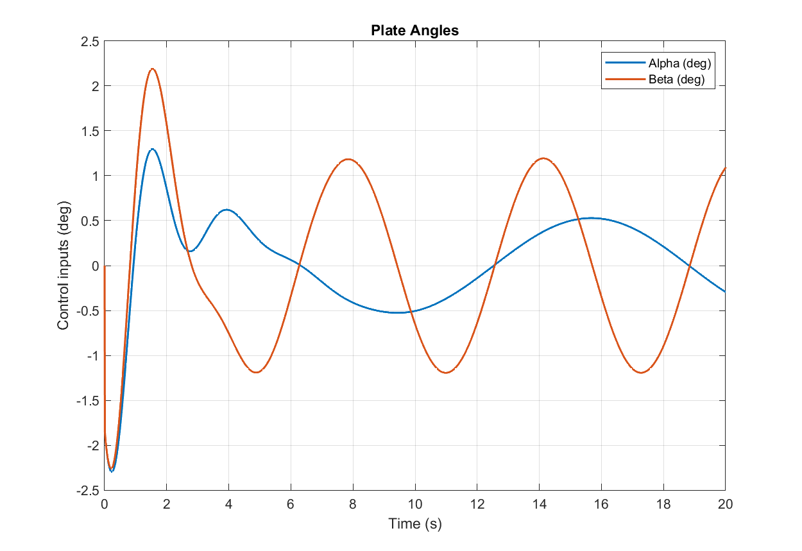
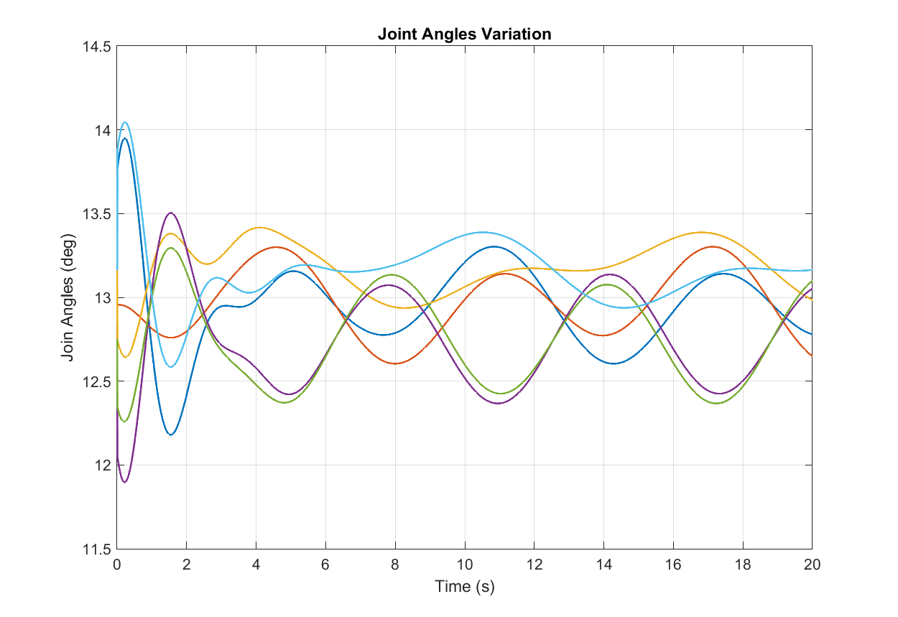
RESULTS
Figure 8 Trajectory - PID

Slide 31
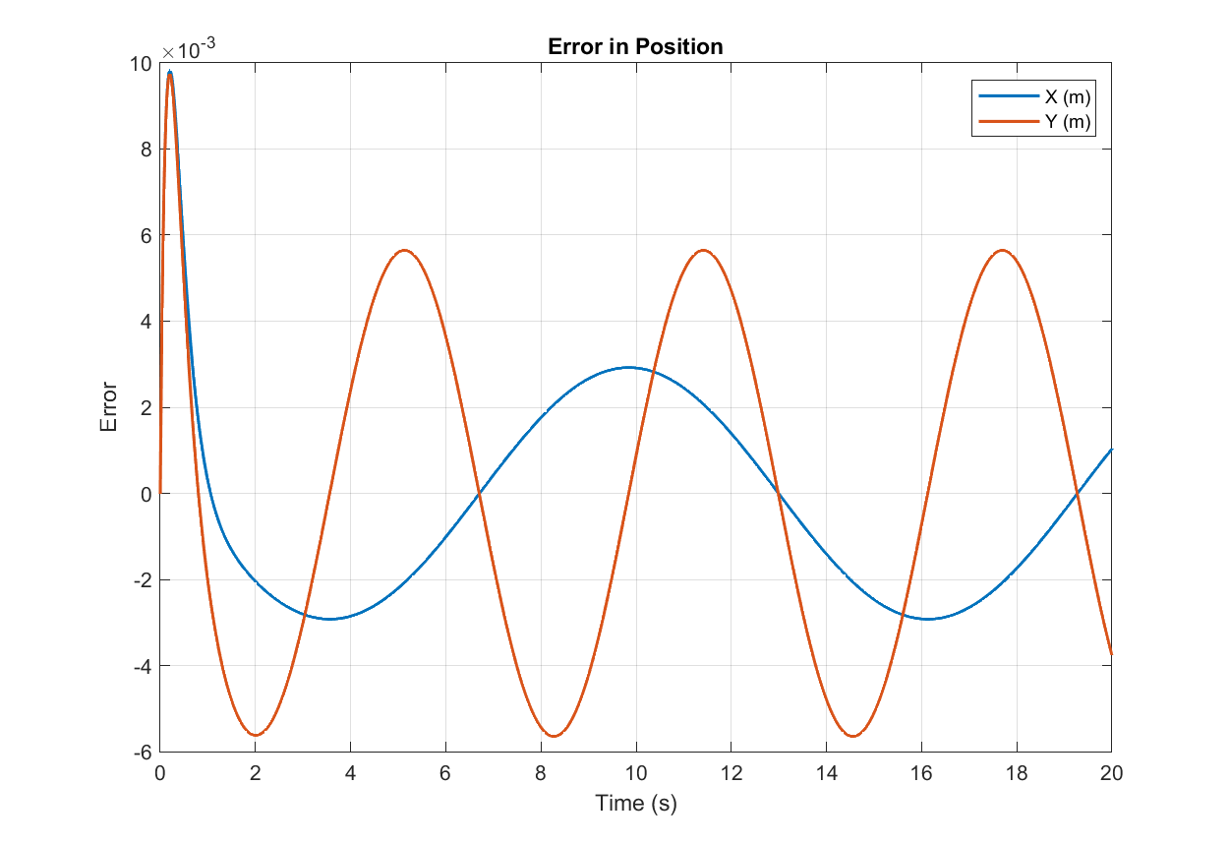
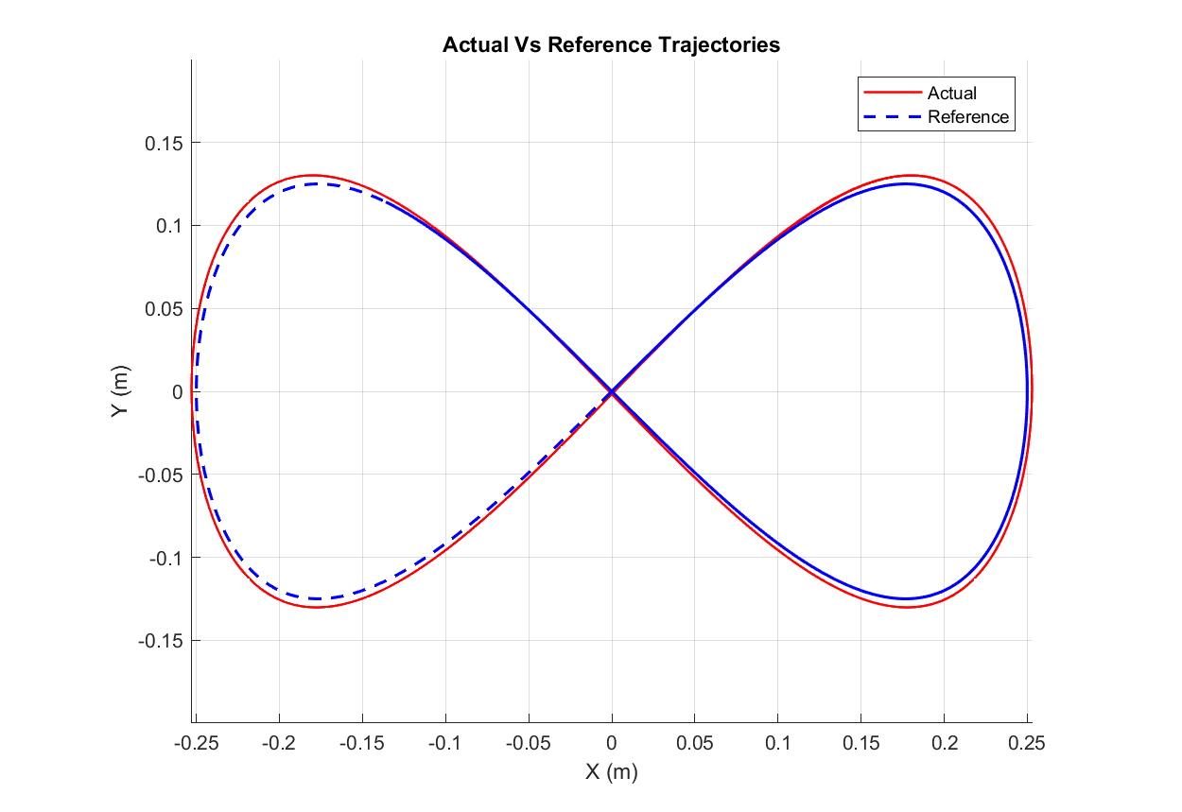
RESULTS
Figure 8 Trajectory - LQR

Slide 32
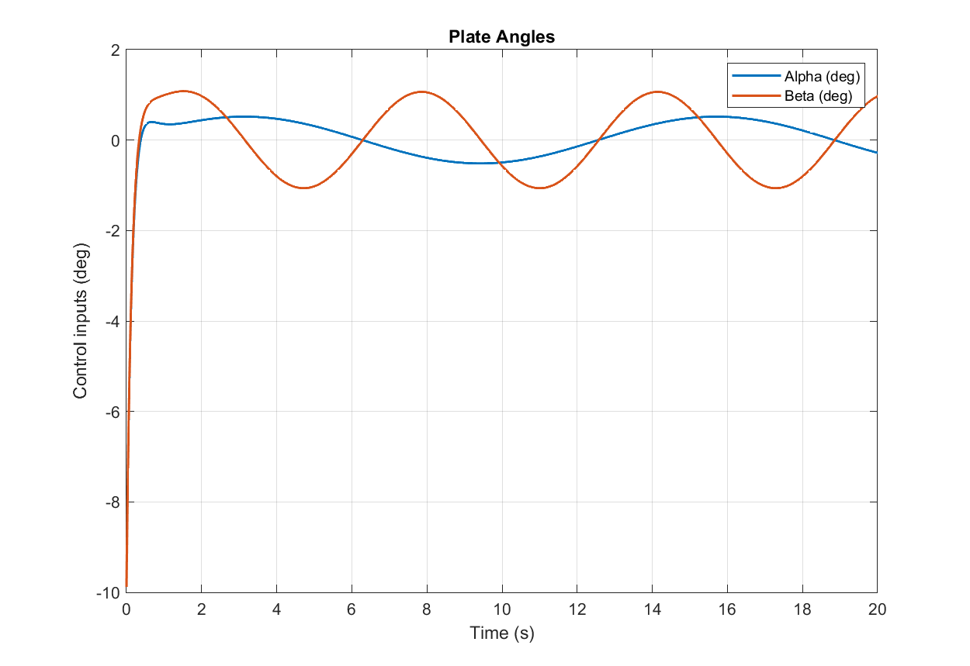
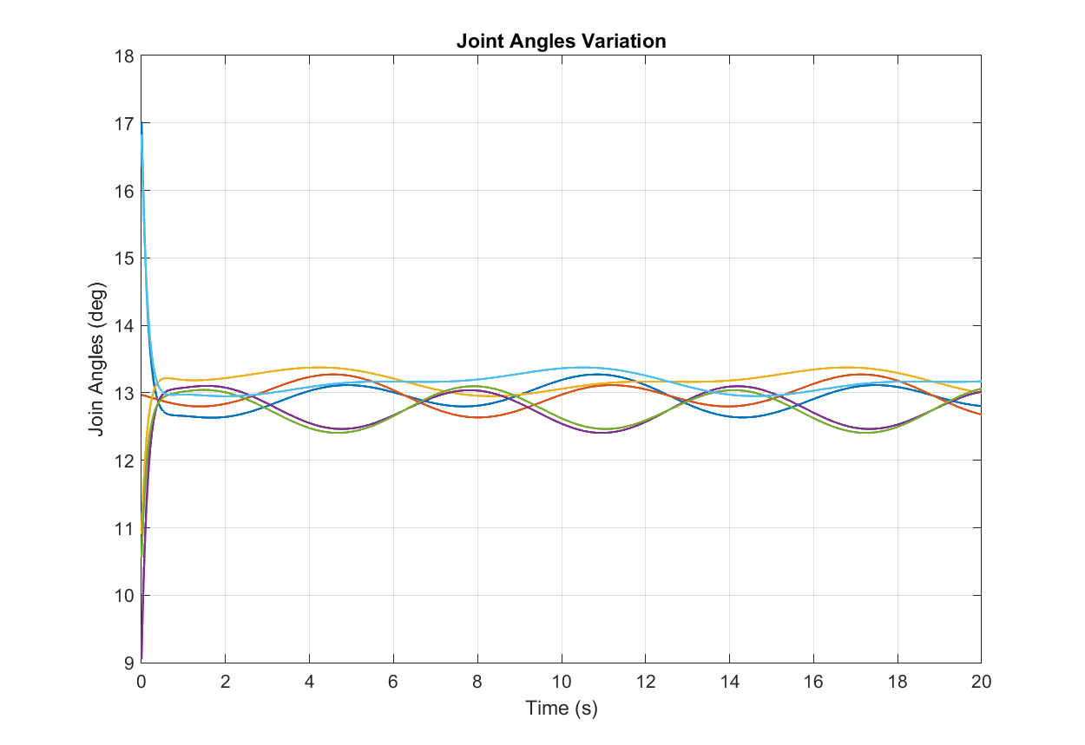
RESULTS
Figure 8 Trajectory - LQR

Slide 33
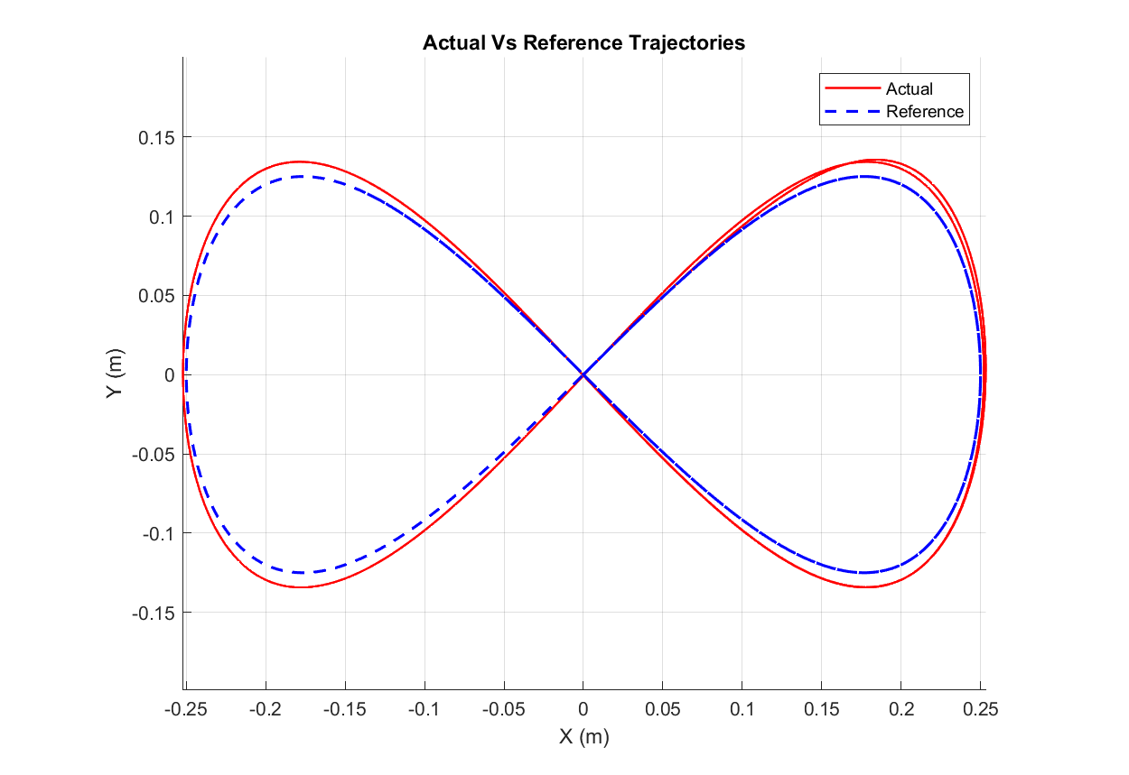
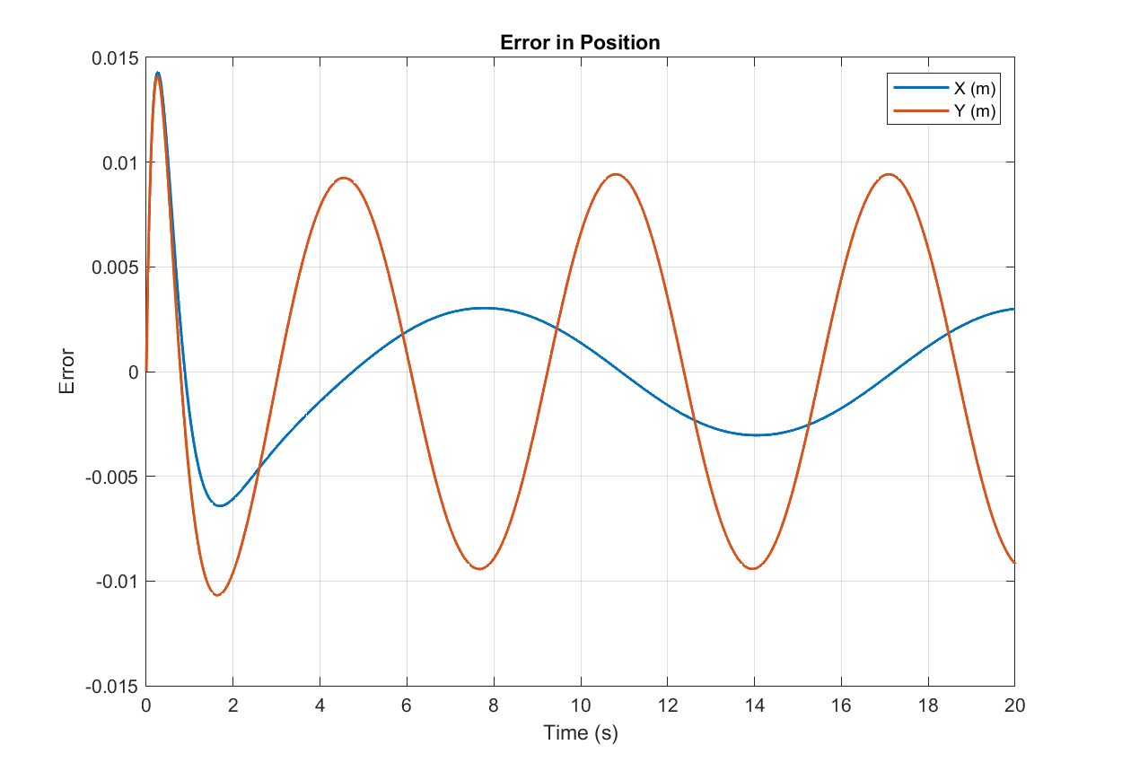
RESULTS
Figure 8 Trajectory - SMC

Slide 34
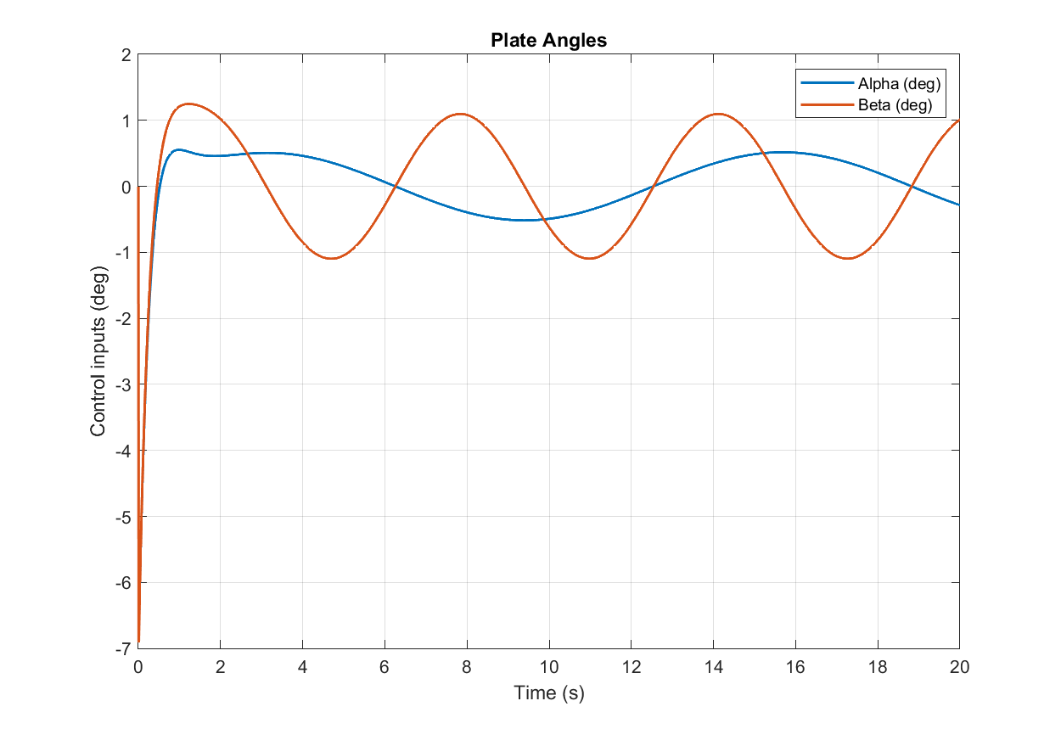
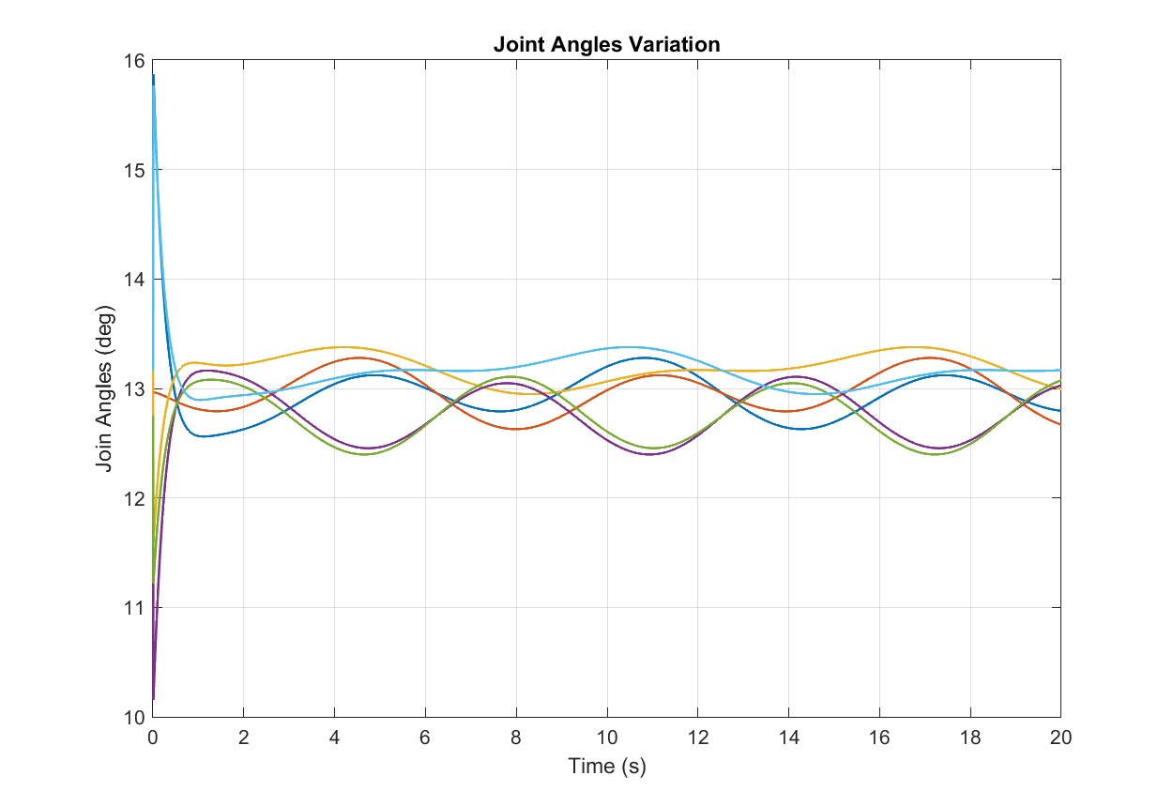
RESULTS
Figure 8 Trajectory - SMC

Slide 35
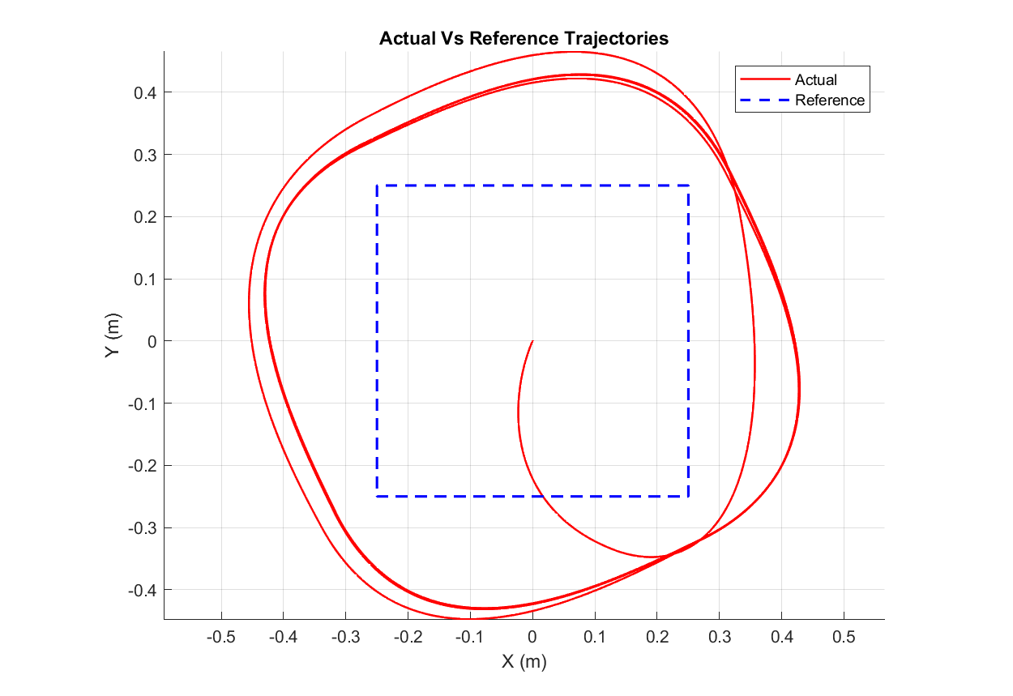
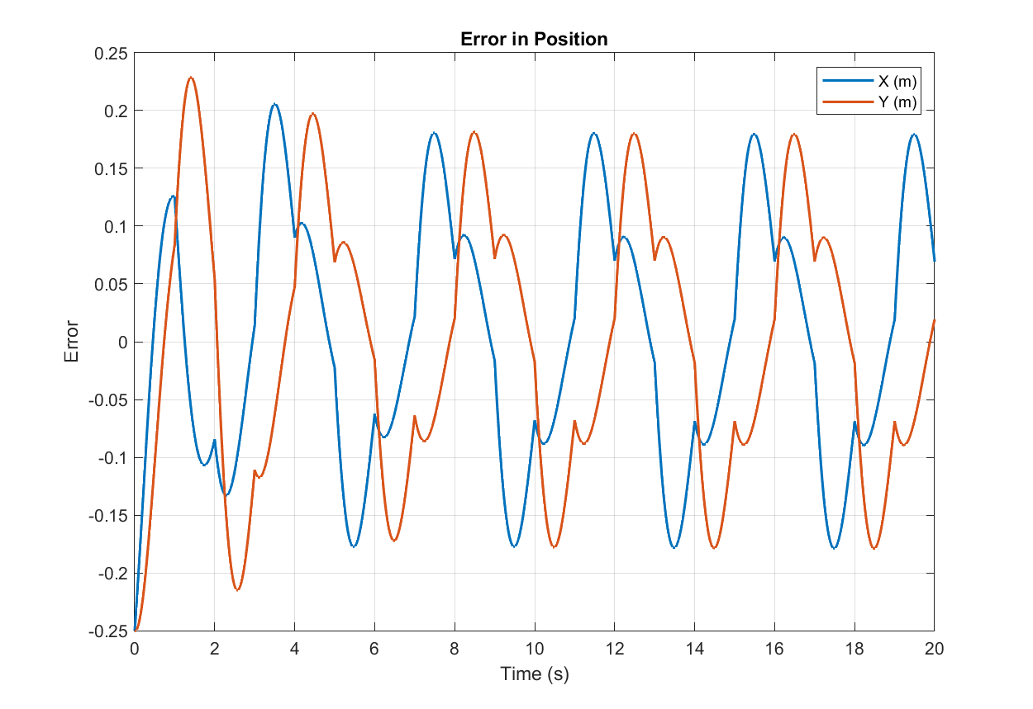
RESULTS
Square Trajectory - PID

Slide 36
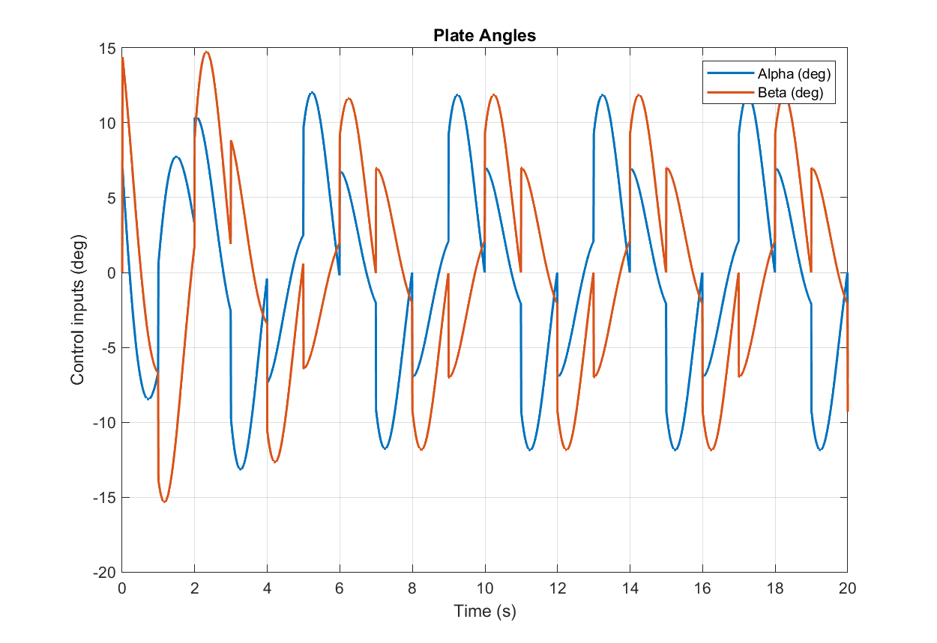
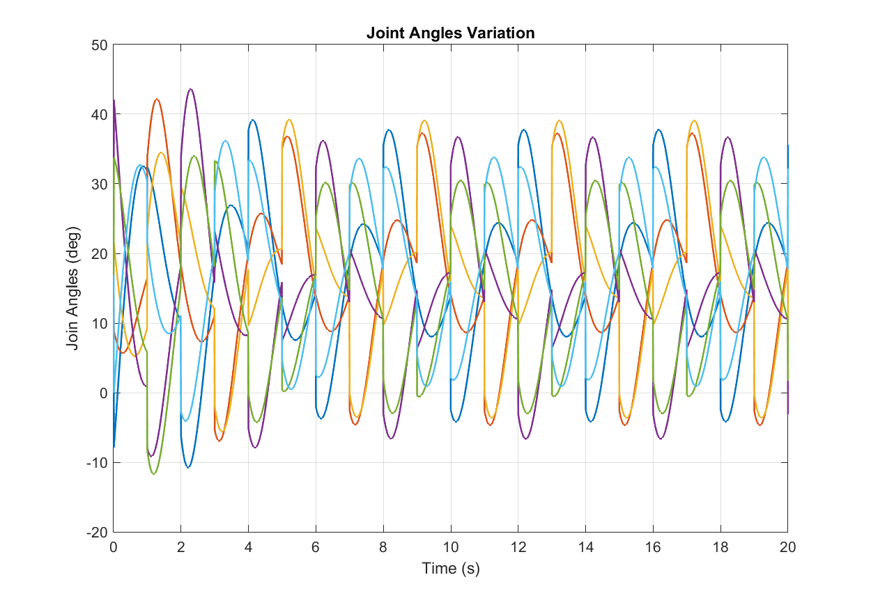
RESULTS
Square Trajectory - PID

Slide 37
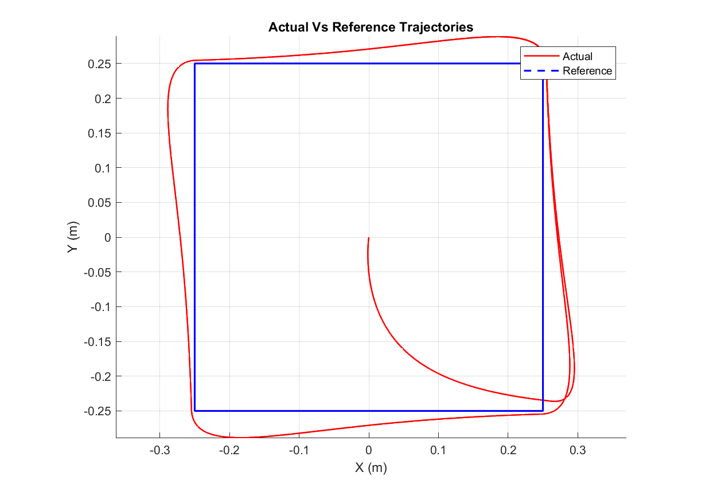

RESULTS
Square Trajectory - LQR

Slide 38


RESULTS
Square Trajectory - LQR

Slide 39


RESULTS
Square Trajectory - SMC

Slide 40


RESULTS
Square Trajectory - SMC

Slide 41


Inverse kinematics
Define the positions of joints on the base and on the platform. We define the following angles to represent the orientation
2
1
 | 1 | 2 | 3 | 4 | 5 | 6
Location of servo on base (deg) r | 60 | 120 | 180 | 240 | 300 | 360
Direction of offset of servo (deg) | 90 | 90 | 240 | 240 | 300 | 300
Orientation of horn (deg) | 180 | 0 | 300 | 120 | 60 | 240
Location of joint on platform | 45 | 135 | 165 | 255 | 285 | 15
3
6
4
5
Position of each joint on the base

Slide 42







Inverse kinematics
Position of each joint on the platform
Platform
2
1
3
6
Joint position wrt to the base frame,
Where, depends on and the input angles fromm the controllers.
Assumption: is a vector of constants -
s.t.,
4
5
L

Slide 43




Inverse kinematics
Now to find the servo angles:
Or,
We write the constants and D in terms of M to get servo angles:

Slide 44


Inverse kinematics
Using the identity
Where,
We get,

Slide 45
REFERENCES
H. Bang and Y. S. Lee, "Implementation of a Ball and Plate Control System Using Sliding Mode Control," in IEEE Access, vol. 6, pp. 32401-32408, 2018
Aghiad KASSEM, Hassan HADDAD, Chadi ALBITAR,"Comparison Between Different Methods of Control of Ball and Plate System with 6DOF Stewart Platform", IFAC-PapersOnLine, Volume 48, Issue 11, 2015, Pages 47-52
Oravec, M., & Jadlovská, A. (2015), “Model Predictive Control of a Ball and Plate laboratory model”, 2015 IEEE 13th International Symposium on Applied Machine Intelligence and Informatics (SAMI), 165-170
Mohammad Nokhbeh & Daniel Khashabi, “Modelling and Control of Ball-Plate System”, Final Project Report, Amirkabir University of Technology, 2011

Slide 46

THANK YOU

